Slide 1
CSE 521 - Operating Systems Fall 2025
Lecture - 9 Threads
Created by Dr. Tevfik Koşar
Presented By
Dr. Zulkar Nine

Slide 2

Roadmap
Threads
Why do we need them?
Threads vs Processes
Threading Examples
Threading Implementation & Multi-threading Models
Other Threading Issues
Thread cancellation
Signal handling
Thread pools
Thread specific data
Notes:
This is the outline of today’s class.

Slide 3
Threads
In classical view, One program (run inside a process)
has single line of execution.
Works sequentially
Program can use threads
To do multiple works simultaneously
Like web browser can run multiple tabs at once.

Slide 4
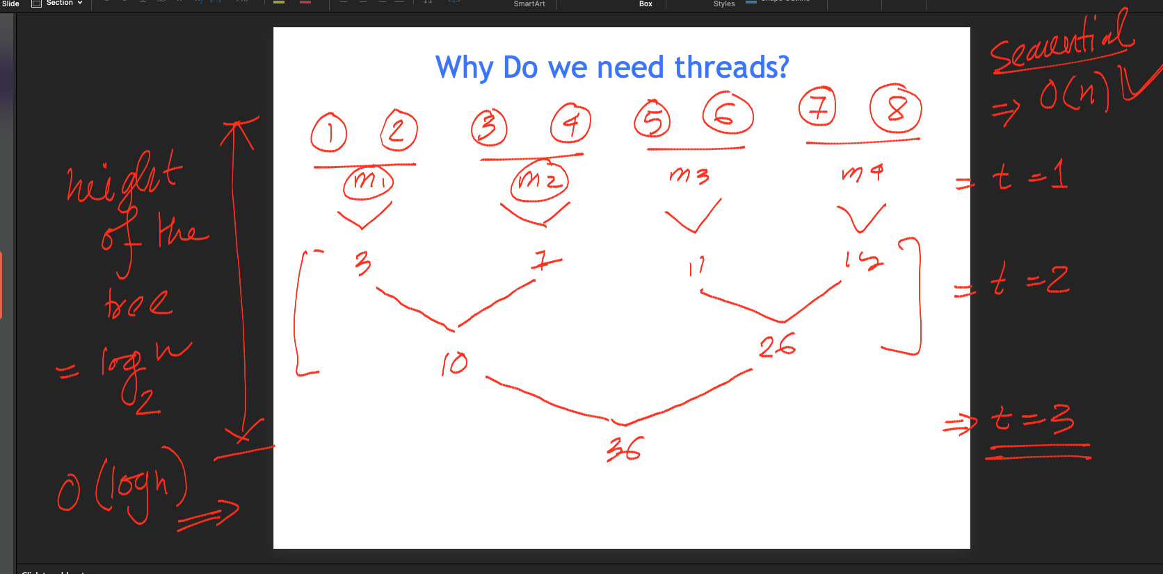
Why Do we need threads?

Slide 5
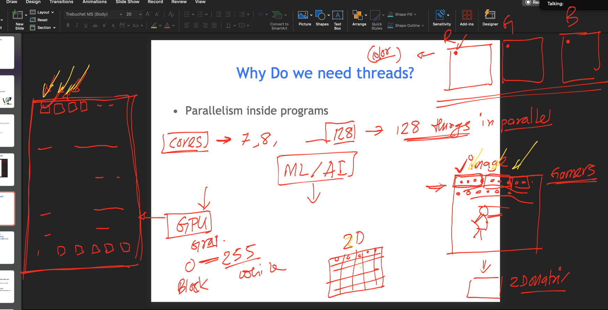
Why Do we need threads?
Parallelism inside programs

Slide 6
Why Do we need threads? Concurrent Programming
In certain cases, a single application may need to run several tasks at the same time
1
1
2
3
2
4
5
3
concurrent
4
5
sequential

Slide 7
Motivation
Increase the performance by running more than one tasks at a time.
divide the program to n smaller pieces, and run it n times faster using n processors
To cope with independent physical devices.
do not wait for a blocked device, perform other operations at the background

Slide 8

Serial vs Parallel
COUNTER
COUNTER 2
COUNTER 1
Q
Please

Slide 9
Divide and Compute
x1 + x2 + x3 + x4 + x5 + x6 + x7 + x8
How many operations with sequential programming?
7
Step 1: x1 + x2
Step 2: x1 + x2 + x3
Step 3: x1 + x2 + x3 + x4
Step 4: x1 + x2 + x3 + x4 + x5
Step 5: x1 + x2 + x3 + x4 + x5 + x6
Step 6: x1 + x2 + x3 + x4 + x5 + x6 + x7
Step 7: x1 + x2 + x3 + x4 + x5 + x6 + x7 + x8

Slide 10
Divide and Compute

Slide 11
Gain from parallelism
In theory:
dividing a program into n smaller parts and running on n processors results in n time speedup
In practice:
This is not true, due to
Communication costs
Dependencies between different program parts
Eg. the addition example can run only in log(n) time not 1/n

Slide 12
Concurrent Programming
Implementation of concurrent tasks:
as separate programs
as a set of processes or threads created by a single program
Execution of concurrent tasks:
on a single processor (can be multiple cores)
on several processors in close proximity
on several processors distributed across a network
➔ Multithreaded programming
➔ Parallel computing
➔ Distributed computing

Slide 13
Benefits of Parallelism
In certain cases, a single application may need to run several tasks at the same time
Creating a new process for each task is time consuming
Use a single process with multiple threads
faster
less overhead for creation, switching, and termination
share the same address space

Slide 14
Why Do we need threads? Reason 2:
Avoid blocking program due to slow I/O
Think about an Email client (such a outlook)
Works that an email client do
Receive emails
Compose emails
Send emails
Calendar notification
If the program is sequential
You cannot write an email, when your email client is receiving an email.

Slide 15
Threading Benefits
Patterns of multithreading usage across applications
perform foreground and background work in parallel
illusion of full-time interactivity toward the user while performing other tasks (same principle as time-sharing)
allow asynchronous processing
separate and desynchronize the execution streams of independent tasks that don’t need to communicate
handle external, surprise events such as client requests
increase speed of execution
“stagger” and overlap CPU execution time and I/O wait time (same principle as multiprogramming)

Slide 16
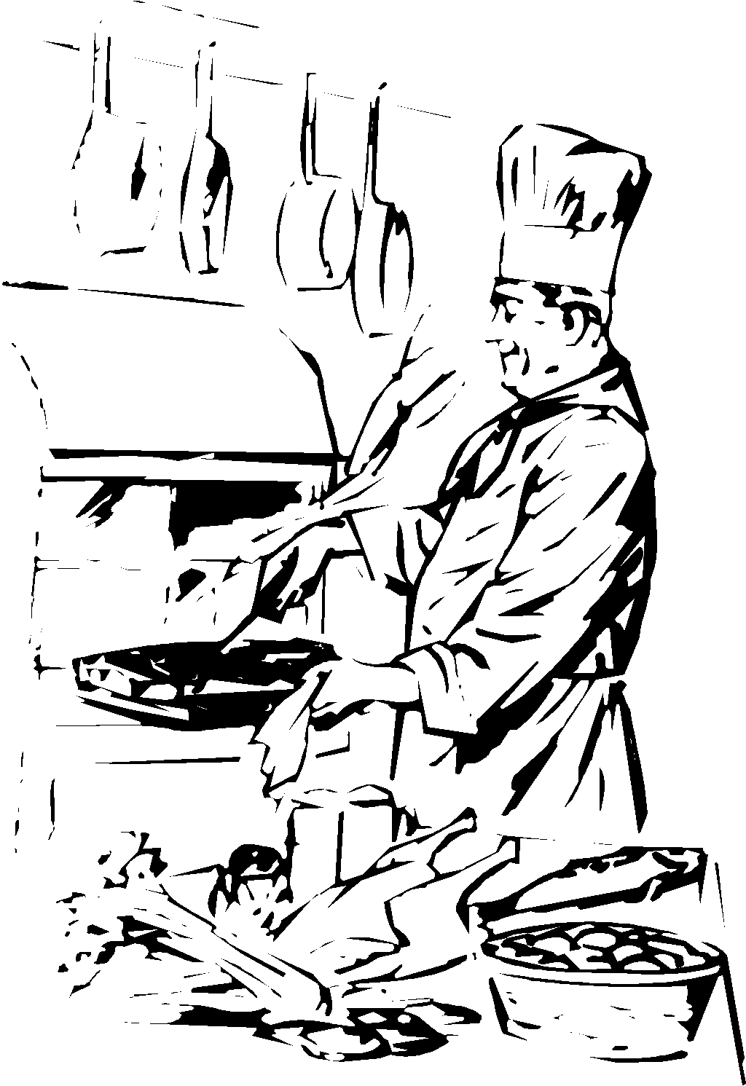

Multi-threading
The execution path is a “thread” that can be multiplied
The execution path is a “thread”
Pasta for six
boil 1 quart salty water
stir in the pasta
cook on medium until “al dente”
serve
same CPU working
on two things
other thread
CPU
thread of execution
input data
Process
Program

Slide 17
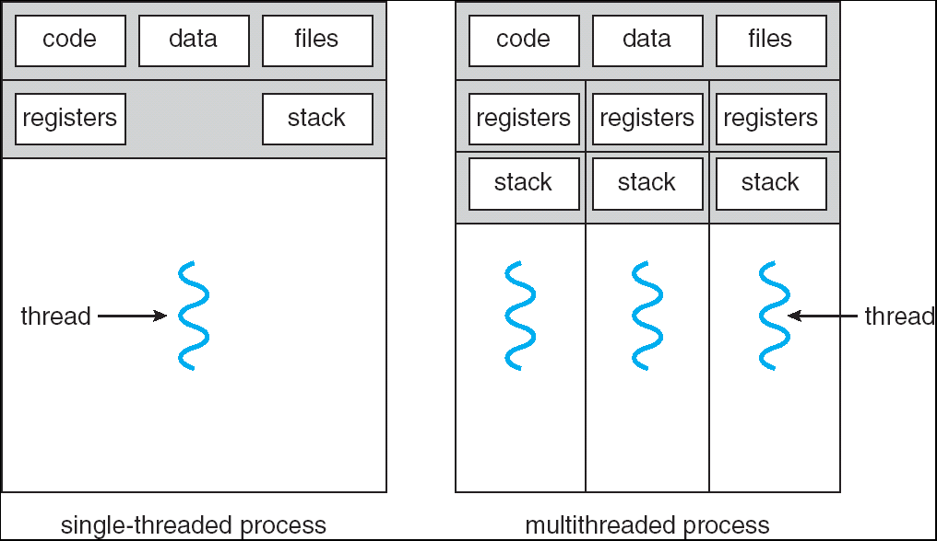
Single and Multithreaded Processes

Slide 18
New Process Description Model
each thread of execution receives its own control block and stack
own execution state (“Running”, “Blocked”, etc.)
own copy of CPU registers
own execution history (stack)
the process keeps a global control block listing resources currently used
Multithreading requires changes in the process description model
process control block (PCB)
process control block (PCB)
stack
thread 1 control block (TCB 1)
data
thread 1 stack
thread 2 control block (TCB 2)
program
code
thread 2 stack
data
program
code
New process image

Slide 19
Per-process vs per-thread items
Per-process items and per-thread items in the control block structures
process identification data
numeric identifiers of the process, the parent process, the user, etc.
CPU state information
user-visible, control & status registers
stack pointers
process control information
scheduling: state, priority, awaited event
used memory and I/O, opened files, etc.
pointer to next PCB
process identification data + thread identifiers
numeric identifiers of the process, the parent process, the user, etc.
CPU state information
user-visible, control & status registers
stack pointers
process control information
scheduling: state, priority, awaited event
used memory and I/O, opened files, etc.
pointer to next PCB

Slide 20
Multi-process model
Process Spawning:
Process creation involves the following four main actions:
setting up the process control block,
allocation of an address space and
loading the program into the allocated address space and
passing on the process control block to the scheduler

Slide 21
Multi-thread model
Thread Spawning:
Threads are created within and belonging to processes
All the threads created within one process share the resources of the process including the address space
Scheduling is performed on a per-thread basis.
The thread model is a finer grain scheduling model than the process model
Threads have a similar lifecycle as the processes and will be managed mainly in the same way as processes are

Slide 22
Threads vs Processes
A common terminology:
Heavyweight Process = Process
Lightweight Process = Thread
Advantages (Thread vs. Process):
Much quicker to create a thread than a process
spawning a new thread only involves allocating a new stack and a new CPU state block
Much quicker to switch between threads than to switch between processes
Threads share data easily
Disadvantages (Thread vs. Process):
Processes are more flexible
They don’t have to run on the same processor
No security between threads: One thread can stomp on another thread's data
For threads which are supported by user thread package instead of the kernel:
If one thread blocks, all threads in task block.

Slide 23
Thread Creation
pthread_create
// creates a new thread executing start_routine
int pthread_create(pthread_t *thread,
const pthread_attr_t *attr,
void *(*start_routine)(void*), void *arg);
pthread_join
// suspends execution of the calling thread until the target
// thread terminates
int pthread_join(pthread_t thread, void **value_ptr);

Slide 24
Thread Example
int main()
{
pthread_t thread1, thread2; /* thread variables */
pthread_create (&thread1, NULL, (void *) &print_message_function,
(void*)”hello “);
pthread_create (&thread2, NULL, (void *) &print_message_function,
(void*)”world!\n”);
pthread_join(thread1, NULL);
pthread_join(thread2, NULL);
exit(0);
}
Why use pthread_join?
To force main block to wait for both threads to terminate, before it exits.
If main block exits, both threads exit, even if the threads have not
finished their work.

Slide 25
Exercise
Consider a process with two concurrent threads T1 and T2. The code being executed by T1 and T2 is as follows:
Shared Data:
X:= 5; Y:=10;
T1: T2:
Y = X+1; U = Y-1;
X = Y; Y = U;
Write X; Write Y;
Assume that each assignment statement on its own is executed as an atomic operation. What are the possible outputs of this process?

Slide 26
Solution
All six statements can be executed in any order. Possible outputs are:
1) 65
2) 56
3) 55
4) 99
5) 66
6) 69
7) 96

Slide 27
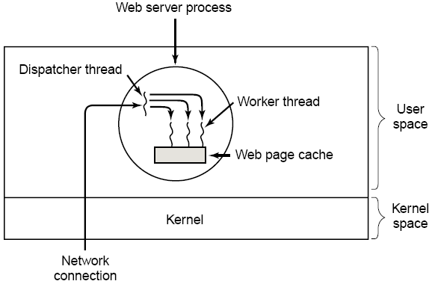
Threading Examples
Web server
as each new request comes in, a “dispatcher thread” spawns a new “worker thread” to read the requested file (worker threads may be discarded or recycled in a “thread pool”)
Tanenbaum, A. S. (2001)
Modern Operating Systems (2nd Edition).
A multithreaded Web server

Slide 28
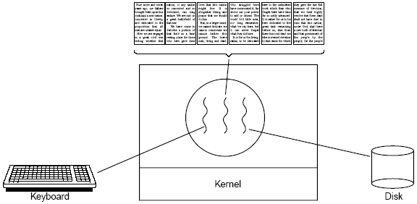
Threading Examples
Word processor
one thread listens continuously to keyboard and mouse events to refresh the GUI; a second thread reformats the document (to prepare page 600); a third thread writes to disk periodically
Tanenbaum, A. S. (2001)
Modern Operating Systems (2nd Edition).
A word processor with three threads

Slide 29
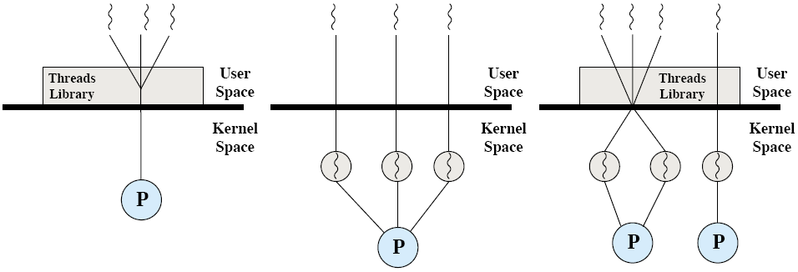
Thread Implementation
Two broad categories of thread implementation
User-Level Threads (ULTs)
Kernel-Level Threads (KLTs)
Stallings, W. (2004) Operating Systems:
Internals and Design Principles (5th Edition).
Pure user-level (ULT), pure kernel-level (KLT) and combined-level (ULT/KLT) threads

Slide 30
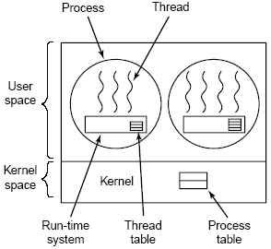
Thread Implementation
User-Level Threads (ULTs)
the kernel is not aware of the existence of threads, it knows only processes with one thread of execution (one PC)
each user process manages its own private thread table
light thread switching: does not need kernel mode privileges
cross-platform: ULTs can run on any underlying O/S
if a thread blocks, the entire process is blocked, including all other threads in it
Tanenbaum, A. S. (2001)
Modern Operating Systems (2nd Edition).
A user-level thread package

Slide 31
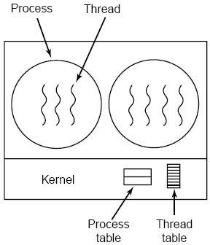
Thread Implementation
Kernel-Level Threads
the kernel knows about and manages the threads: creating and destroying threads are system calls
fine-grain scheduling, done on a thread basis
if a thread blocks, another one can be scheduled without blocking the whole process
heavy thread switching involving mode switch
Tanenbaum, A. S. (2001)
Modern Operating Systems (2nd Edition).
A kernel-level thread package

Slide 32
Different Multi-threading Models
Many-to-One
One-to-One
Many-to-Many
Hybrid

Slide 33
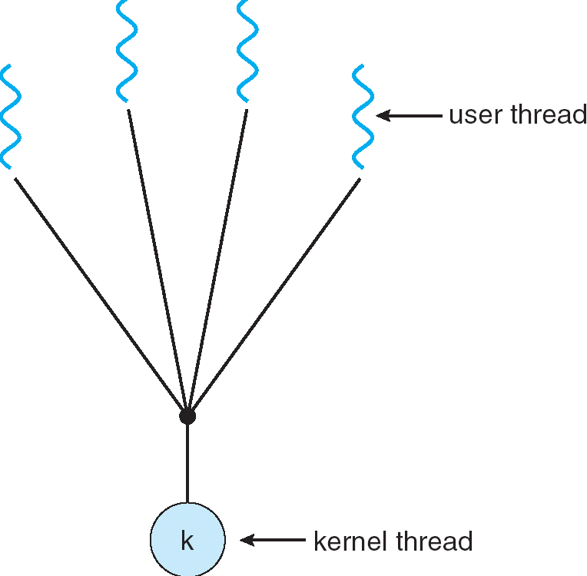
Many-to-One Model
Several user-level threads mapped to single kernel thread
Thread management in user space → efficient
If a thread blocks, entire process blocks
One thread can access the kernel at a time → limits parallelism
Examples:
Solaris Green Threads
GNU Portable Threads

Slide 34
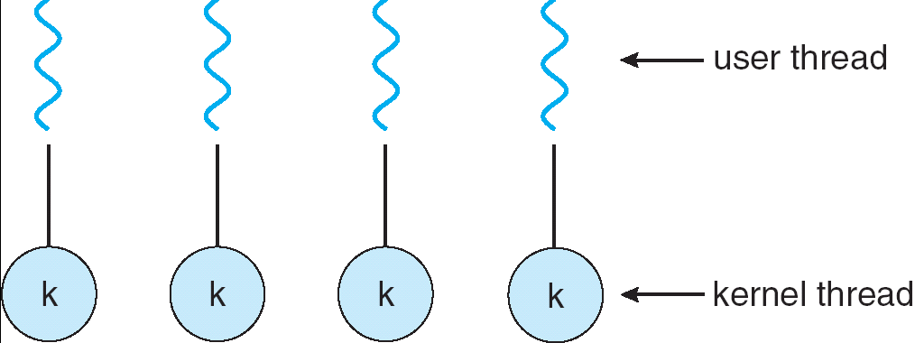
One-to-One Model
Each user-level thread maps to a kernel thread
A blocking thread does not block other threads
Multiple threads can access kernel concurrently → increased parallelism
Drawback: Creating a user level thread requires creating a kernel level thread → increased overhead and limited number of threads
Examples: Windows, Linux, mac OS, iOS, FreeBSD

Slide 35
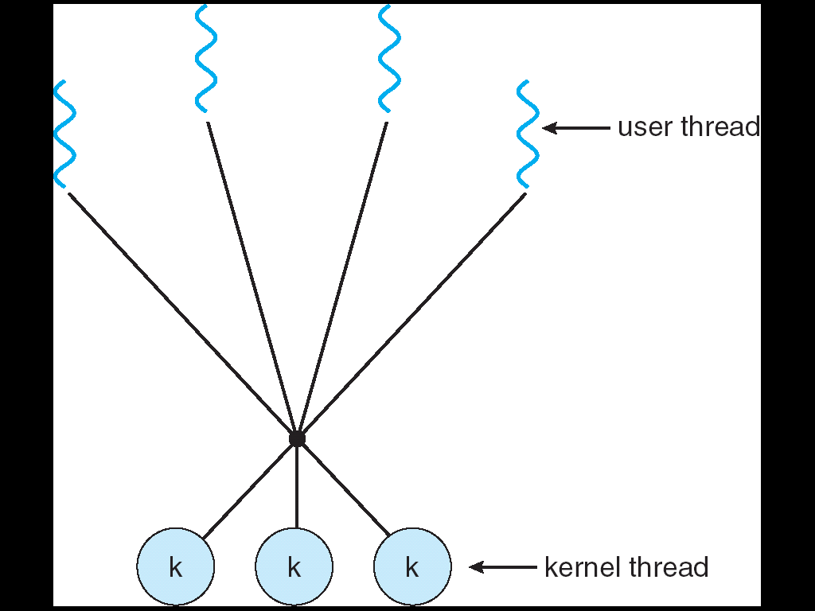
Many-to-Many Model
Allows many user level threads to be mapped to a smaller number of kernel threads
Allows the operating system to create a sufficient number of kernel threads
Increased parallelism as well as efficiency
Solaris prior to version 9
Windows NT/2000 with the ThreadFiber package

Slide 36
Threading Issues
Thread pools
Thread specific data
Semantics of fork() and exec() system calls
Thread cancellation

Slide 37
Thread Pools
Threads come with some overhead as well
Unlimited threads can exhaust system resources, such as CPU or memory
Create a number of threads at process startup) and put them in a pool, where they await work
When a server receives a request, it awakens a thread from this pool
Advantages:
Usually faster to service a request with an existing thread than create a new thread
Allows the number of threads in the application(s) to be bound to the size of the pool
Number of threads in the pool can be setup according to:
Number of CPUs, memory, expected number of concurrent requests

Slide 38
Semantics of fork() and exec()
Semantics of fork() and exec() system calls change in a multithreaded program
Eg. if one thread in a multithreaded program calls fork()
Should the new process duplicate all threads?
Or should it be single-threaded?
Some UNIX systems implement two versions of fork()
If a thread executes exec() system call
Entire process will be replaced, including all threads

Slide 39
Summary
Why do we need them?
Threads vs Processes
Threading Examples
Threading Implementation & Multi-threading Models
Other Threading Issues
Thread cancellation
Signal handling
Thread pools
Thread specific data
Hmm..

Slide 40
How to Prepare for a Pintos Quiz?
From the Pintos Manual, read the following sections:
Section 1 - Introduction
Section 2 - Threads
Appendix A1- Pintos Loading
Appendix A2 - Threads
Appendix A3 - Synchronization
Appendix B - 4.4BSD Scheduler

Slide 41
Acknowledgements
“Operating Systems Concepts” book and supplementary material by A. Silberschatz, P. Galvin and G. Gagne
“Operating Systems: Internals and Design Principles” book and supplementary material by W. Stallings
“Modern Operating Systems” book and supplementary material by A. Tanenbaum
Dr. Kosar from UB, R. Doursat and M. Yuksel from UNR

